Slide 1
Simulating tourism water consumption with stakeholders (SIMTWIST)
Bas Amelung, Wageningen University
Water JPI 2018 Joint Call 12 April 2019, Stockholm

Slide 2
OBJECTIVES
General objective:
To improve the understanding of the tourism water footprint and to help reduce tourism stakeholders’ water consumption by informing public and private decision-makers about the effectiveness of different types of interventions.
Specific objectives:
To assess the water availability conditions in each of the case study areas;
To estimate current tourism-related water consumption;
To explore the future prospects of water scarcity in the case study areas;
To examine the interactions between water, social power and infrastructure;
To determine the key behavioural rules that guide water consumption;
To test the effectiveness of various public and private intervention options as potential tools to monitor and reduce water consumption.

Slide 3
CONSORTIUM DESCRIPTION
Wageningen University, Netherlands (PI: Bas Amelung)
Project leader
Companion modelling
Agent-based modelling
University of Alicante, Spain (PI: Antonio Rico Amorós)
Coordination of the Benidorm case study analysis
Hydrosocial analysis
University of Bologna (PI: Elena Toth)
Coordination of the Rimini case study analysis
Hydrological analysis

Slide 4
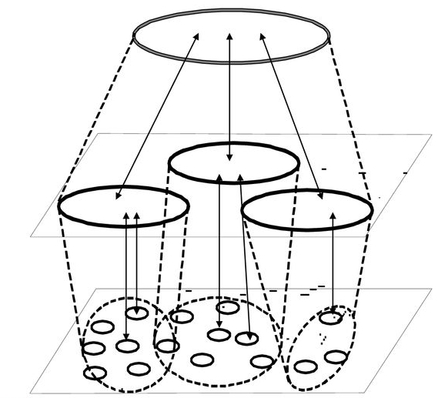
CONSORTIUM DESCRIPTION
Macro
Water scarcity
(Climate change, tourism trends)
Lead: Bologna (Elena Toth)
Meso (regime)
Hydrosocial cycle
(Power)
Lead: Alicante (Antonio Rico)
Micro
ABM, ComMod
(Individual behaviour)
Lead: Wageningen (Bas Amelung)

Slide 5
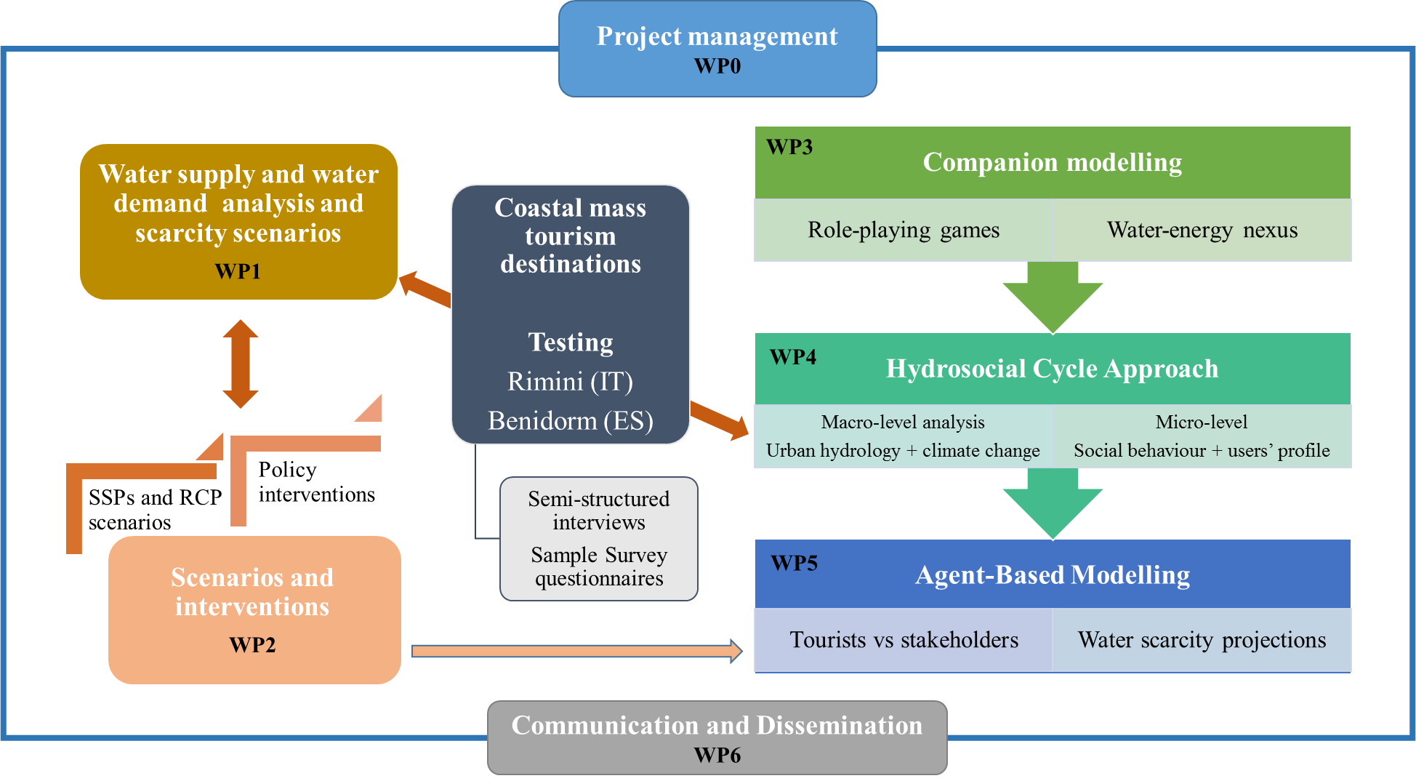
WP DESCRIPTION

Slide 6
EXPECTED IMPACT OF THE PROJECT
Scientific
Link macro-level (water scarcity) challenges to micro-level (water use) behaviour
Innovation
Focus on tourism
Focus on behaviour of individual actors
Interdisciplinary approach: integrating disciplines
Transdisciplinary approach: stakeholder-oriented
Societal
SDG 6: increase water-use efficiency, ensure sustainable withdrawals
SDG 13: improve education, awareness-raising and human and institutional capacity on climate change adaptation
Knowledge: level of consumption, main components, key incentives
Methodologies: replication of suit of tools, incl. demand modelling, hydrosocial cycle analysis, companion modelling, serious games and agent-based modelling

Slide 7
Any comments?

